Slide 1
May, 2023
INSTRUCTOR
STUDENT
BITS Pilani.
Pilani Campus
Dr. Abhishek Mishra.
Chaitanya Krishna Chauhan
2020A4PS1859P
Dr. Ashutosh Bhatia
Presentation
Assignment
CRYPTOGRAPHY
A Survey of Privacy-Preserving Biometric Authentication: Techniques and Challenges
BITS Pilani, Pilani Campus

Slide 2
TABLE OF CONTENTS
BIOMETRIC AUTHENTICATION SYSTEM
BIOMETRIC AUTHENTICATION TECHNIQUES
01
INTRODUCTION
02
03
04
BIOMETRIC AUTHENTICATION
CHALLENGES
05
CONCLUSION
BITS Pilani, Pilani Campus

Slide 3
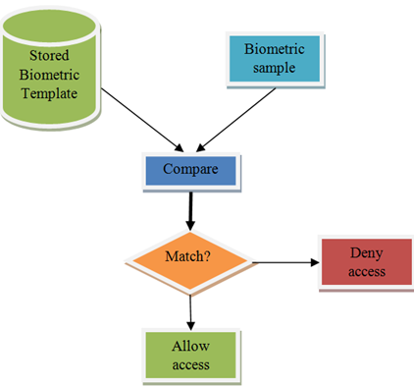
INTRODUCTION
Biometric authentication has become a popular means of providing security in various applications.
It involves using physiological and/or behavioral characteristics to verify an individual's identity, which eliminates the need for traditional passwords and PINs.
With the advancement of technology, recognizing humans based on their body features has become more fascinating, and biometric authentication is a concrete way of identification used by many firms today.
The concept of remembering one’s password is also eliminated with this step and is gaining popularity for industrial usage.
BITS Pilani, Pilani Campus

Slide 4
BIOMETRIC AUTHENTICATION
SYSTEM
Biometric authentication is a security mechanism that uses a person's physical characteristics to verify their identity. The process begins with enrollment, where new users are registered into a database by capturing information about a certain characteristic of the person.
When a person needs to be recognized, the system will take required measurements, translate this information into a template using the same algorithm.
If a match is found in the enrolled users, then access will be granted; otherwise, an appropriate message will be displayed, and access will be denied.
All logs of authentication, successful and unsuccessful, are recorded in a file for audit purposes.
Comparison
Enrollment
BIOMETRIC
Feature Extraction
Authentication Request
BITS Pilani, Pilani Campus

Slide 5




BIOMETRIC AUTHENTICATION TECHNIQUES
BIOMETRIC AUTHENTICATION TECHNIQUES USE UNIQUE PHYSIOLOGICAL OR BEHAVIORAL CHARACTERISTICS TO VERIFY AN INDIVIDUAL'S IDENTITY
FINGERPRINT RECOGNITION
IRIS RECOGNITION
FACE RECOGNITION
VOICE RECOGNITION
This technique uses the unique pattern of ridges and furrows on a person's fingers to verify their identity.
This technique uses special cameras to record the iris removing eyelids and eyelashes to verify one's identity.
This technique uses the unique facial features of individuals for distinguishing between them.
This technique uses the unique voice characteristics like pitch, speed and tone to recognize an individual.
BITS Pilani, Pilani Campus

Slide 6




BIOMETRIC AUTHENTICATION TECHNIQUES
BIOMETRIC AUTHENTICATION TECHNIQUES USE UNIQUE PHYSIOLOGICAL OR BEHAVIORAL CHARACTERISTICS TO VERIFY AN INDIVIDUAL'S IDENTITY
PALM PRINT
SIGNATURE
DNA
GAIT
This technique uses the distinct patterns on hands. Due to larger surface are, it provides more authentication security in theory.
This technique uses special cameras to record the digital signature and convert it to bytes for storage and checking.
This technique uses the uniqueness of DNA structure of cells to find unique ID's of everyone.
This technique uses the unique gait or manner of walking of an individual. It looks for contours for identification.
BITS Pilani, Pilani Campus

Slide 7
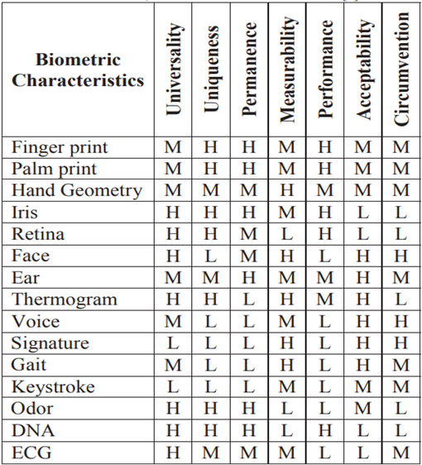

Multimodal biometrics
Multimodal biometrics as the name suggests, is related to combining of multiple biometric techniques.
Each one of the aforementioned techniques are strong in their own way but with some limitations. Due to this fact, we can combine them together and increase the overall security of the system thereby preserving privacy.
BITS Pilani, Pilani Campus

Slide 8
CHALLENGES
There are several challenges associated with biometric authentication that need to be addressed:
Privacy
Privacy is one of the major concern when it comes to biometrics where people might not provide consent to use any body feature.
A covert or passive demand can be easily turned down by the audience leading to a bad market and can highly turn down the uses of biometrics. Moreover, biometrics are sensitive personal data of individuals
Template protection
The BAS system must be secure to prevent any privilege escalation and unauthorized access of sensitive data from the system. Most existing privacy preserving biometric systems have focus on storing the biometric data in a modified version and keeping the original data safe.
One solution to solve the above mentioned problem is to follow protection schemes like cancellable and bio hashing.
BITS Pilani, Pilani Campus

Slide 9
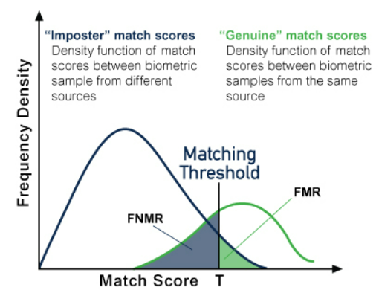
Inaccuracy
Biometric authentication systems need to be more accurate in identifying individuals. Moreover, in image processing biometrics, we need to be make sure that the captured images are clear and in optimum resolutions
An analysis by a defense evangelist at KnowBe4 stats that according to NIST evaluation ratings, it is aimed to have as less as 1 error per 100,000 tests which is an accuracy goal of 1:1000000.
The best results till now have an error of 1.9 % which is nearly 2 mistakes for every 100 tests [25]. Another key factor is theoretical accuracy vs real world accuracy. Theoretically, facial recognition is much more discerning because it can consider a large number of data points.
BITS Pilani, Pilani Campus

Slide 10

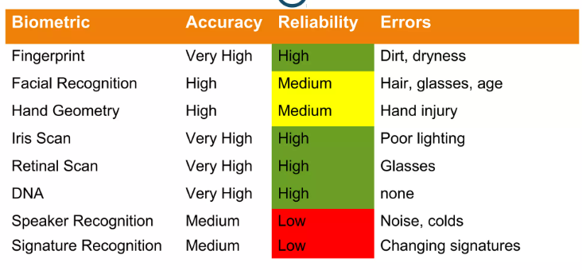
Inaccuracy
BITS Pilani, Pilani Campus

Slide 11

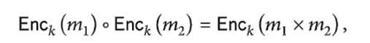
Cryptographic Primitives
Cryptographic primitives, such as AES and RSA, are effective in preserving privacy during biometric authentication.
Employing cryptographic primitive techniques can reduce errors in biometric authentication results.
Secure multiparty computation (SMPC) is a commonly used cryptographic tool to protect private information during biometric authentication.
SMPC employs homomorphic encryption, oblivious transfer, and garbled circuits.
After completing computations, the server sends the result and proof of correct computation to the client.
BITS Pilani, Pilani Campus

Slide 12
CONCLUSION
Several methods for privacy-preserving biometric authentication have been highlighted in the study, including homomorphic encryption, secure multiparty computation, and biometric template protection.
Although these methods have shown impressive results in preserving user privacy, they also have their own set of drawbacks, including a rise in computational complexity and a drop in recognition precision.
Multimodal biometric systems are likely to have a bright future since they solve some of the issues with unimodal biometric systems.They not only enhance matching performance but also deal with spoofing and nonuniversality issues.
BITS Pilani, Pilani Campus

Slide 13

THANK YOU

